Slide 1
Dave Perman
Product Manager
August 25, 2014
Product Architecture Training (PAT)
IBM Case Manager 5.2.1
New Feature Overview

Slide 2
Introduction
Course Overview
  High level overview of the new capabilities of ICM 5.2.1
Target Audience:
  Sales, Technical Sales, Services, Support
Prerequisites:
  ICM 5.2 Pxts
Version Release Date – September 2014
© Copyright International Business Machines Corporation 2014. All Rights Reserved.
US Government Users Restricted Rights - Use, duplication or disclosure restricted by GSA ADP Schedule Contract with IBM Corp.

Slide 3
Course Objectives
After this course you will be able to:
Describe at a high level, the new capabilities on IBM Case Manager 5.2.1
Identify other ICM 5.2.1 PxT presentations that will provide more detailed information
Know where to go for additional information

Slide 4
ICM Elevator Pitch
IBM Case Manager:
For Global Enterprises and SMB organizations who need to create business solutions that expose structured and unstructured business information (business data and content) and allows structured (business) and unstructured (social) organizations to execute work (routine and emergent tasks) in a secure but transparent manner.
ICM provides our customers and partners the tools they need to design and develop case style solutions on the IBM ECM platform significantly faster and with lower development costs.
Primary objectives for this release are to deliver customer value by:
Supporting the creation of case solutions where individual cases can include documents that reside in external repositories including FileNet, CMOD, CM8 and others via CMIS
Allowing solution creators to use advanced task modeling without the need for complex data modeling workarounds, process modeling or custom code, resulting in a reduction in complexity and custom coding
Providing the ability for solution creators to define highly customized UIs that meet client requirements, resulting in a reduction in complexity and development time
Notes:
In plain English describe what value the customer is going to receive from this offering.
Really describe the value the customer will get.
Think about how you will describe:
What is your product?
What does it do?
What problem does it solve?
What is the goal of this release?
Each of these questions should be able to be formulated in a sentence or 2 as a summary message.
Including some context of product roadmap on the elevator pitch may be helpful context to the reviews.

Slide 5



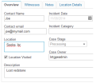










ICM 5.2.1 – September 2014
Include Content From Other Repositories
Include External Data in Property Views
Push In-baskets
Task Properties
To-do Tasks
Additional Page Layout Configurations
New APIs for Creating Custom Data Editors
Social Information for Case Documents
Zero Download Viewer Support
Add Case Documents With Entry Templates
File Tracking, Favorites and Desktop Sync
Expanded Platform Support

Slide 6
Include Content From Other Repositories
General Use Case
  Many organizations store their documents in multiple repositories
  This is often due to:
    Specialized storage such as IBM CMOD
    Departmental partitioning
    Mixed vendor products
    Legacy repositories still in use
  Cases often contain an aggregation of documents from many sources
Specific Use Case
  A banking customer opens a credit card dispute case
  The case contains a scan of the customer’s invoice
  It also includes the customer’s credit card statement that resides in CMOD
  Case knowledge workers can interact in the same way with both these documents regardless of their actual source
  External documents do not need to be copied (duplicated) into the case

Slide 7
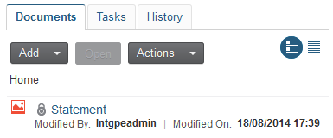
Include Content From Other Repositories
From Case Builder, a Solution Creator can
  Mark a case type as allowing external documents to be filed or added as attachments
From ICN Admin, an Administrator can
  Configure a Desktop to include the repositories where users can file external documents from – including all repository types supported by ICN (CM8, CMIS, other P8 object stores, CMOD)
From Case Client, a Case Worker can
  Search for documents from another repository to add them to the case or attach to a workflow
  Interact directly with the document, such as modifying properties, viewing the content, versioning, and interacting with the document as an attachment
CMOD document referenced by a case

Slide 8
Include External Data in Property Views
General Use Case
  Most organizations maintain several “systems of record” data sources
  These data sources often contain the most current “single source of truth”
  Easy access to this information helps case workers complete their work
  It is often necessary, and efficient, to access this data live and not store a copy
Specific Use Case
  While working a claim for a customer, an agent opens the case details
  Along side the claim specific data, the agent sees the customer’s contact information, pulled live from their client database
  A list of past transactions is also conveniently displayed, saving the agent from having to access another system

Slide 9
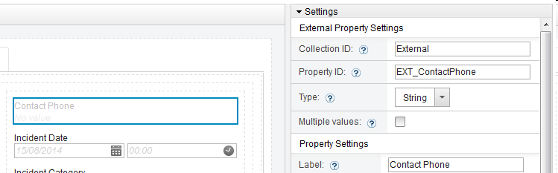
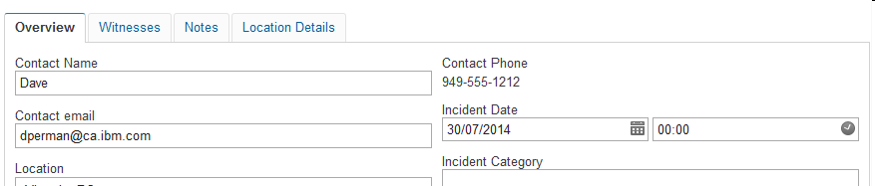
Include External Data in Property Views
Placeholder added to a property view
A script is added to the page that gets data from another system based on one of the existing case properties
The returned data is mixed into the view with the case properties
The external property is never persisted with the case data itself and is always accurate
External properties can be both read-only and read-write
External property placeholder added to view
External property value set at runtime

Slide 10
Push In-baskets
General Use Case
  Teams of heads down task workers process items from shared queues of work in support of driving a case to completion
  Some of these workers may decide to open items of lower priority or ones that, from their experience, are easier to complete
  Hiding the list of items and delivering them in a prioritized way ensures work is being performed in an optimal way
Specific Use Case
  An insurance claims processor’s performance is measured by number of claims they review
  Experienced processors are able to recognize claims that typically take longer to process
  Providing a simple “get next” button that hands out the next item in the sorted queue ensures an even distribution of work

Slide 11
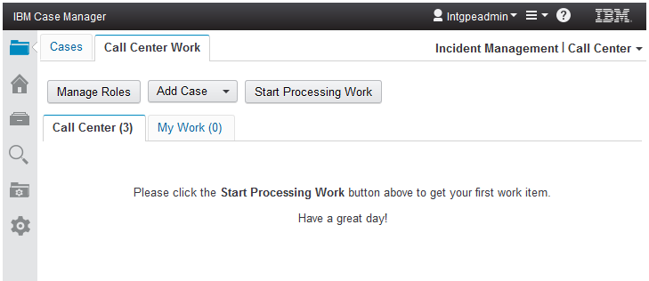
Push In-baskets
Work items are not shown in the in-basket
Users click a button to start processing work
Ordering of delivered items is controlled by in-basket configuration
Works in conjunction with the step’s “Get next” feature
Add your own custom message
Hide list contents configuration option
Add your own custom message

Slide 12
Task Properties
General Use Case
  Case tasks, particularly ones that might repeat, may need to capture and store data specific to that task for reporting or auditing
  Various complex workarounds were often used, resulting in the data being persisted in unique ways
Specific Use Case
  A repeatable task is used to automate the arrival and review of documents added to the case folder
  During the review steps, some information about the document is entered in task property fields that are displayed to the end user
  When the task and its workflow complete, the data is already stored with the task object with no additional development work required

Slide 13
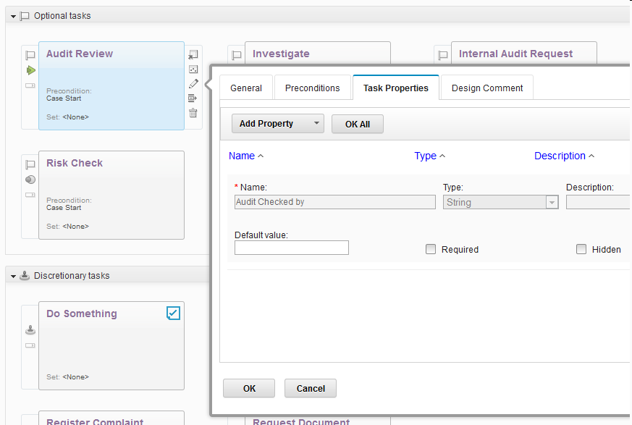
Task Properties - Design
Can be added to any task type
Add to property views like any other case or workflow data field
Task property data can be accessed in Process Designer using the F_CaseTask.taskProp notation in pre or post assignment expressions

Slide 14
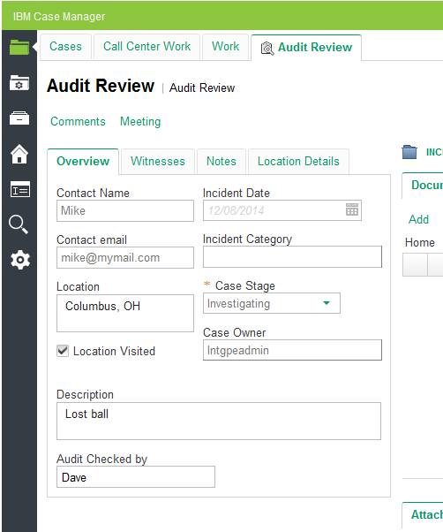
Task Properties - Runtime
Displayed in any property view as designed along with other case properties or workflow data fields
Case properties stored on the case folder
Task property stored on the task instance

Slide 15
To-do Tasks
General Use Case
  Cases typically have a set of things that need to be done to successfully move a case to completion
  Some of these things can be as simple as “check that a specific document is included”
  These “to-do” items require no workflow behind them
  They simply need to be easily visible and available when viewing the case
  You do want to be able to control when certain to-dos are visible or required
  You also want to track in the case’s history when a to-do was completed and by whom
Specific Use Case
  When an incident case type specifies that the incident type was an accident, a set of extra data is required to capture things like “Was there a witness?”, “Was the accident site visited?”, etc

Slide 16
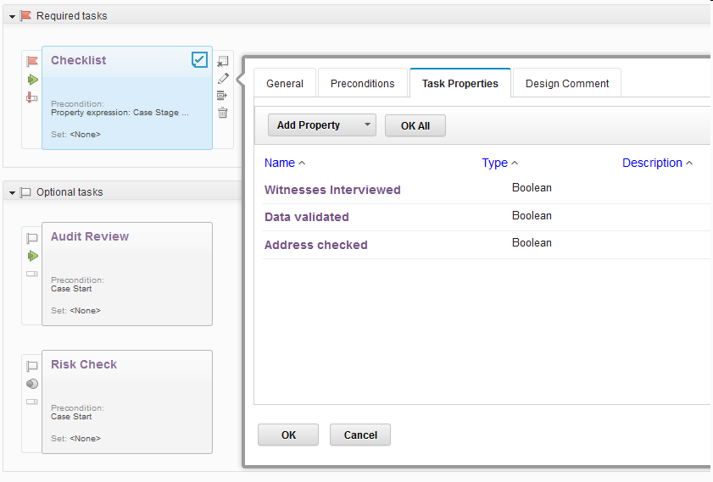
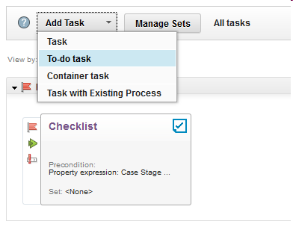
To-do Tasks - Design
Created like any other task type
Supports automatic and discretionary modes
Uses task properties to store any optional data captured as part of the to-do task
Does not have underlying workflow

Slide 17
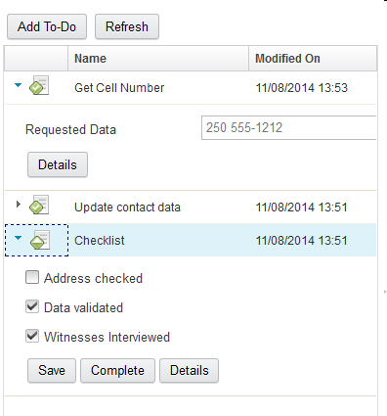
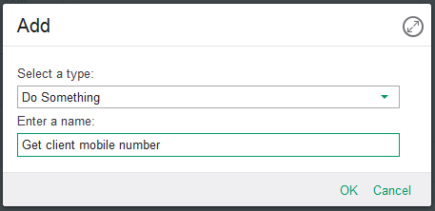
To-do Tasks - Runtime
To-do tasks are displayed in their own To-do widget
Customizable actions allow saving, completing, disabling, and enabling To-do items
Case workers can add To-do items on the fly

Slide 18
Additional Page Layout Configurations
General Use Case
  For solutions that require UIs with many out-of-the-box or custom widgets, flexible page layouts are key to ensuring case data is presented in an efficient, intuitive way
Specific Use Case
  Create a two column layout for the work page with the In-basket on the left and a collapsible Case Information widget on the right

Slide 19
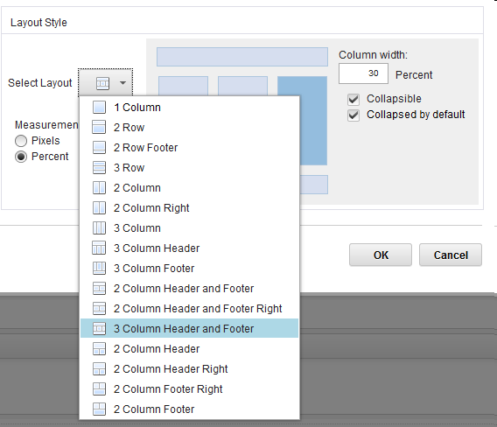
Additional Page Layout Configurations
Provides eight additional layout combinations
Supports collapsible left/right columns, headers and footers
Collapsible columns can be shown/hidden with a simple wiring event

Slide 20
New APIs for Creating Custom Data Editors
General Use Case
  The ICM user interface includes several standard controls for entering case data of various data types
  Some solutions may require various specific controls that help users enter the correct values
Specific Use Case
  A case solution has a boolean property that can be used to enter values like “Yes/No”, “True/False”, checked / unchecked
  These values can often contain a third state; that being “I have not answered this yet”
  A more explicit control is needed to clearly indicate this potentially ambiguous state

Slide 21
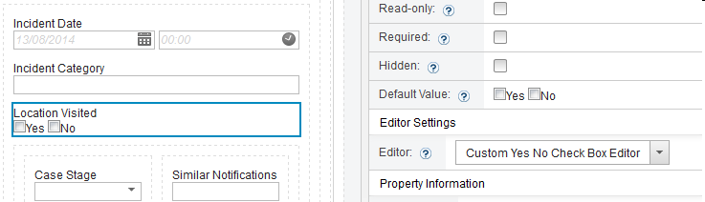
New APIs for Creating Custom Data Editors
Custom property editors can be created as Navigator plug-ins
They provide not only custom UI for a property, but optional configuration settings for that UI
They are registered into ICM using a CMAC task
Once registered, they appear as additional choices for a property editor
Custom editors are registered once and available for any solution
Custom editor displayed in view designer

Slide 22
Social Information for Case Documents
General Use Case
  When collaborating on a case with a team of knowledge workers, it is often helpful to know when case documents have been downloaded or liked
  Tagging provides a quick way of categorizing related documents; making them easier to find later
Specific Use Case
  A case worker has added a set of documents to a case folder
  Over the next several days, the worker is able to see who downloaded the documents, who liked the content, and tag it with keywords that can help other users of the content locate it quickly

Slide 23
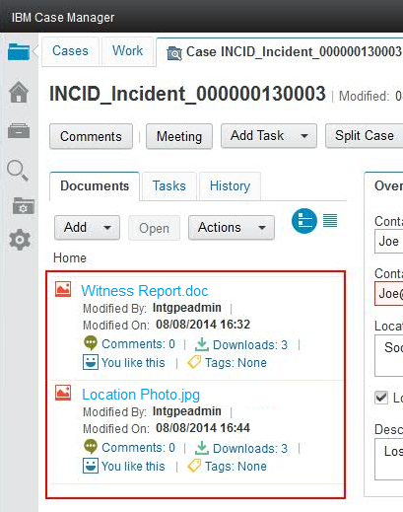
Social Information for Case Documents
Social information like comments, tags, likes and download counts are maintained natively in an object store by the Content Platform Engine.
This information is optionally displayed directly in the document magazine view or in a document’s property page

Slide 24
Zero Download Viewer Support
General Use Case
  Viewing a document that resides in a content repository used to require an initial acceptance and download of a large viewer java applet
  Although feature rich, the viewer applet may not be required by all users
  The viewer applet may also not be supported on all user devices
Specific Use Case
  A case folder has a spreadsheet document filed in it that a user needs to review quickly
  When they click the document, it is rendered on the server and quickly delivered to the case’s Viewer widget
  No long applet downloads or startup is required to view the spreadsheet

Slide 25
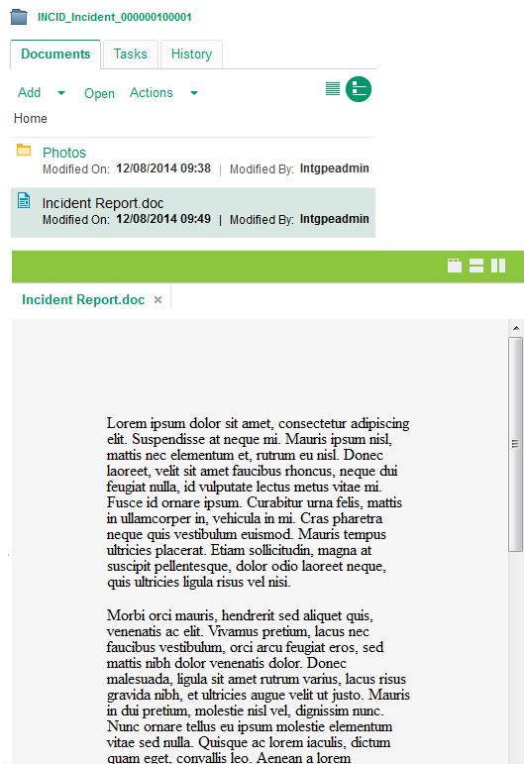
Zero Download Viewer Support
ICM Viewer page widget now supports the new Navigator zero download document viewer
Documents that are part of a case can be viewed directly on the page without requiring a download of the viewer applet
Documents of many formats are rendered quickly on the server and delivered for viewing to the client
Office document rendered on server and displayed in the ICM Viewer widget

Slide 26
Add Case Documents With Entry Templates
General Use Case
  Adding documents into a content repository can often be time consuming and confusing if doc class, doc properties, and security is required
  A user must also know to select the correct document class in the first place
Specific Use Case
  A user is adding an incident report document into their case
  The solution has a document class defined for that type of document that includes several pieces of meta data that need to be entered by the end users
  An Entry Template is created that uses the case’s incident report doc class
  It also sets default security and predefines any default meta data values
  An ICM toolbar button or menu named “Add Incident Report” is added to the case details page using ICM’s new Entry Template action
  The user is now taken directly into the correct Entry Template, reducing clicks and the chance of error

Slide 27
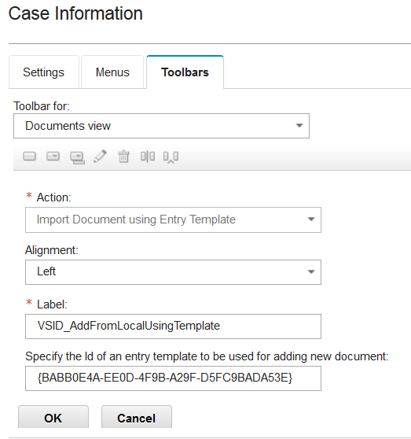
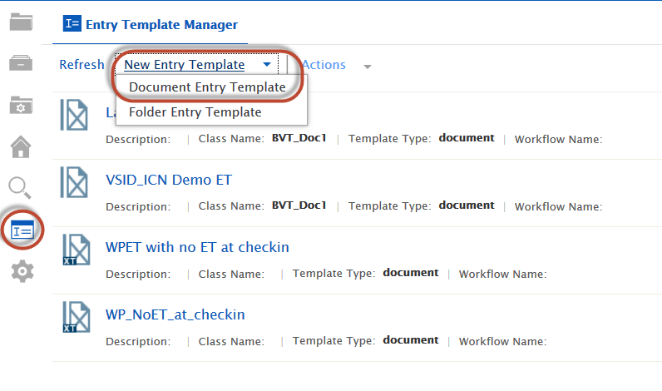
Add Case Documents With Entry Templates
Navigator 2.0.3 has a new Entry Template design feature
In ICM, a new menu action allows you to invoke the Entry Template and also have the resulting document filed in the case

Slide 28
File Tracking, Favorites and Desktop Sync
General Use Case
  Working with documents that reside in a content repository often requires extra user actions
  Users would like to streamline the number of clicks needed, while still benefiting from an ECM environment
Specific Use Case
  A user checks out and downloads a document from a case that they are going to edit on their local machine
  The system remembers where they like to keep their downloaded files
  When the user checks the file back in, the system remembers where the document was downloaded and does not make you search for it
  When a user is actively working on a set of favorite files, the system can keep the online and offline files automatically synchronized so the latest version is always available in both places

Slide 29
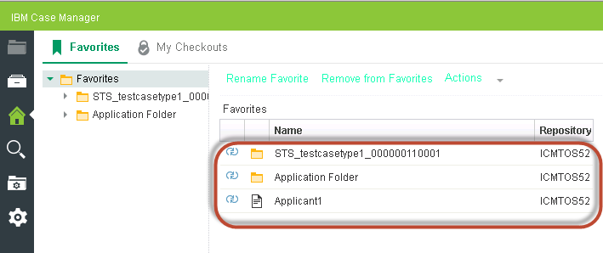
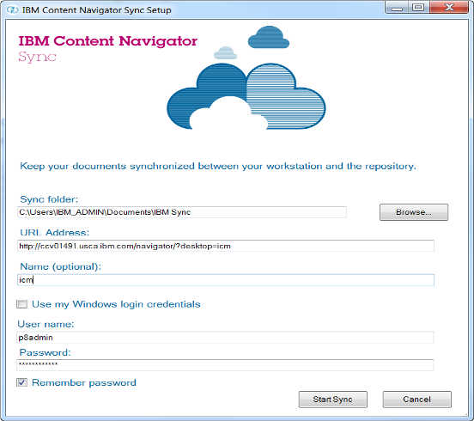
File Tracking, Favorites and Desktop Sync
File Tracking and desktop synchronization are part of the new Content Navigator 2.0.3 release and available to Case Manager which is built on the Navigator framework
There is a new ICM menu action that allows you to identify case documents, folders, and from the Case List, the entire case folder itself as Favorites
Once in the Navigator favorites, the user can configure synchronization

Slide 30
Expanded Platform Support
Servers
  Windows Server 2012 R2
Server Virtualization - Note that ICM follows the general IBM support policy for virtualization, so while these specific tools have been tested, you can use any tools that meet the support policy criteria: http://www-01.ibm.com/software/support/virtualization_policy.html
  VMware ESX Server (x86-64, x86-32) 5.1
  HyperV Windows Server 2012 R2
Desktop – Case client running in supported browsers
  Windows Desktop 8.1
Web Browsers
  Internet Explorer 11
Java
  Oracle JRE 8.0
Databases
  Oracle 12cR1 (12.1.0.1)
  DB2 PureScale 10.1, 10.5
App Servers
  WebLogic 12c (12.1.2)
SSO
  ISAM 7.0
  SAML SAML 2.0 (WAS 8.0+ only)
  CA SiteMinder with WebLogic 12
  Kerberos/Active Directory (WAS 8.5, 8.5.5 & WL 12c) AD 2012 R2
Once ICM 5.2.1 is released, get detailed reports on what is supported here:
  http://pic.dhe.ibm.com/infocenter/prodguid/v1r0/clarity/index.html

Slide 31
Product Help/Documentation/Resources
IBM Case Manager 5.2.1 Knowledge Center
  http://www.ibm.com/support/knowledgecenter/SSCTJ4_5.2.1/com.ibm.casemgmttoc.doc/casemanager_5.2.1.htm
IBM Case Manager 5.2 Information
  http://pic.dhe.ibm.com/infocenter/casemgmt/v5r2m0/index.jsp
IBM Content Navigator 2.0.3 Knowledge Center
  http://www.ibm.com/support/knowledgecenter/SSEUEX_2.0.3/contentnavigator_2.0.3.htm
IBM FileNet 5.2 Knowledge Center
  http://www.ibm.com/support/knowledgecenter/SSNW2F_5.2.0/com.ibm.p8toc.doc/filenetcontentmanager_5.2.0.htm
IBM Support: Fix Central
  http://www.ibm.com/support/fixcentral/

Slide 32
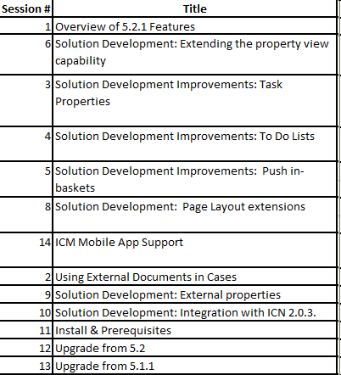
Detailed PxTs

Slide 33
Course Summary
You have completed this course and can:
Describe at a high level, the new capabilities in IBM Case Manager 5.2.1
Identify other ICM 5.2.1 PxT presentations that will provide more detailed information
Know where to go for additional information

Slide 34
Contacts
Product Marketing Manager:
  William (Doc) Mills
Product Manager:
  Dave Perman – ICM
  Mike Fannon – Case Foundation
Subject Matter Experts (SME)/Area of Expertise:
  Mohammed Attar – Case Manager Business Leader
  Steven Hsieh – ICM Architect
  Allen Takatsuka – ICM Technical Sales Leader

